Slide 1
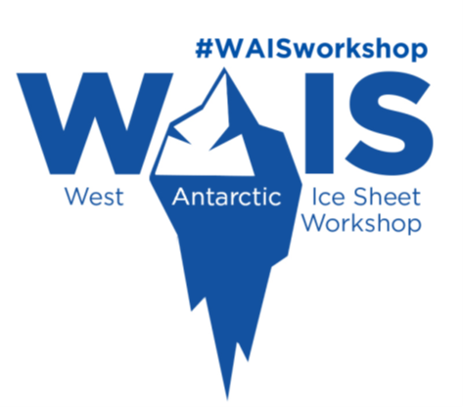
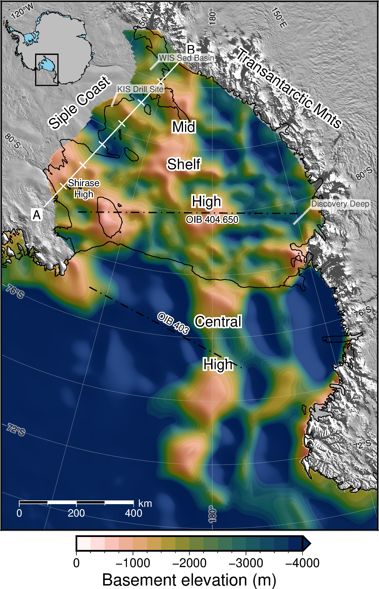
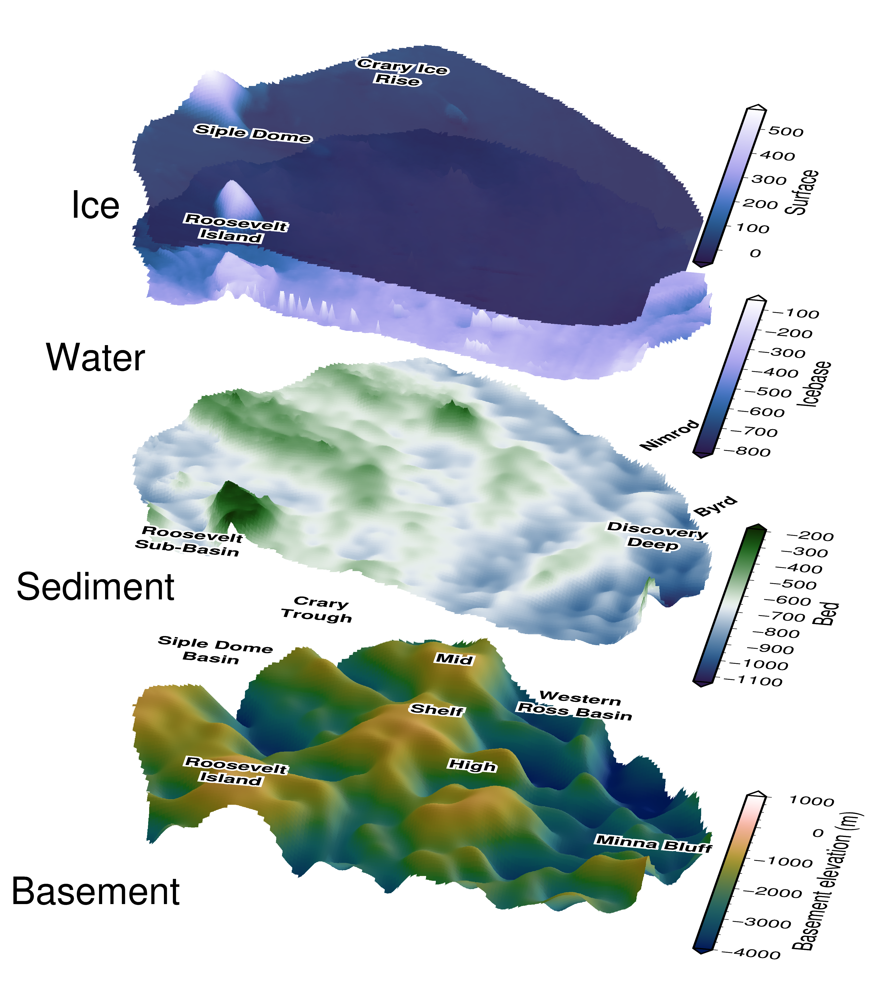
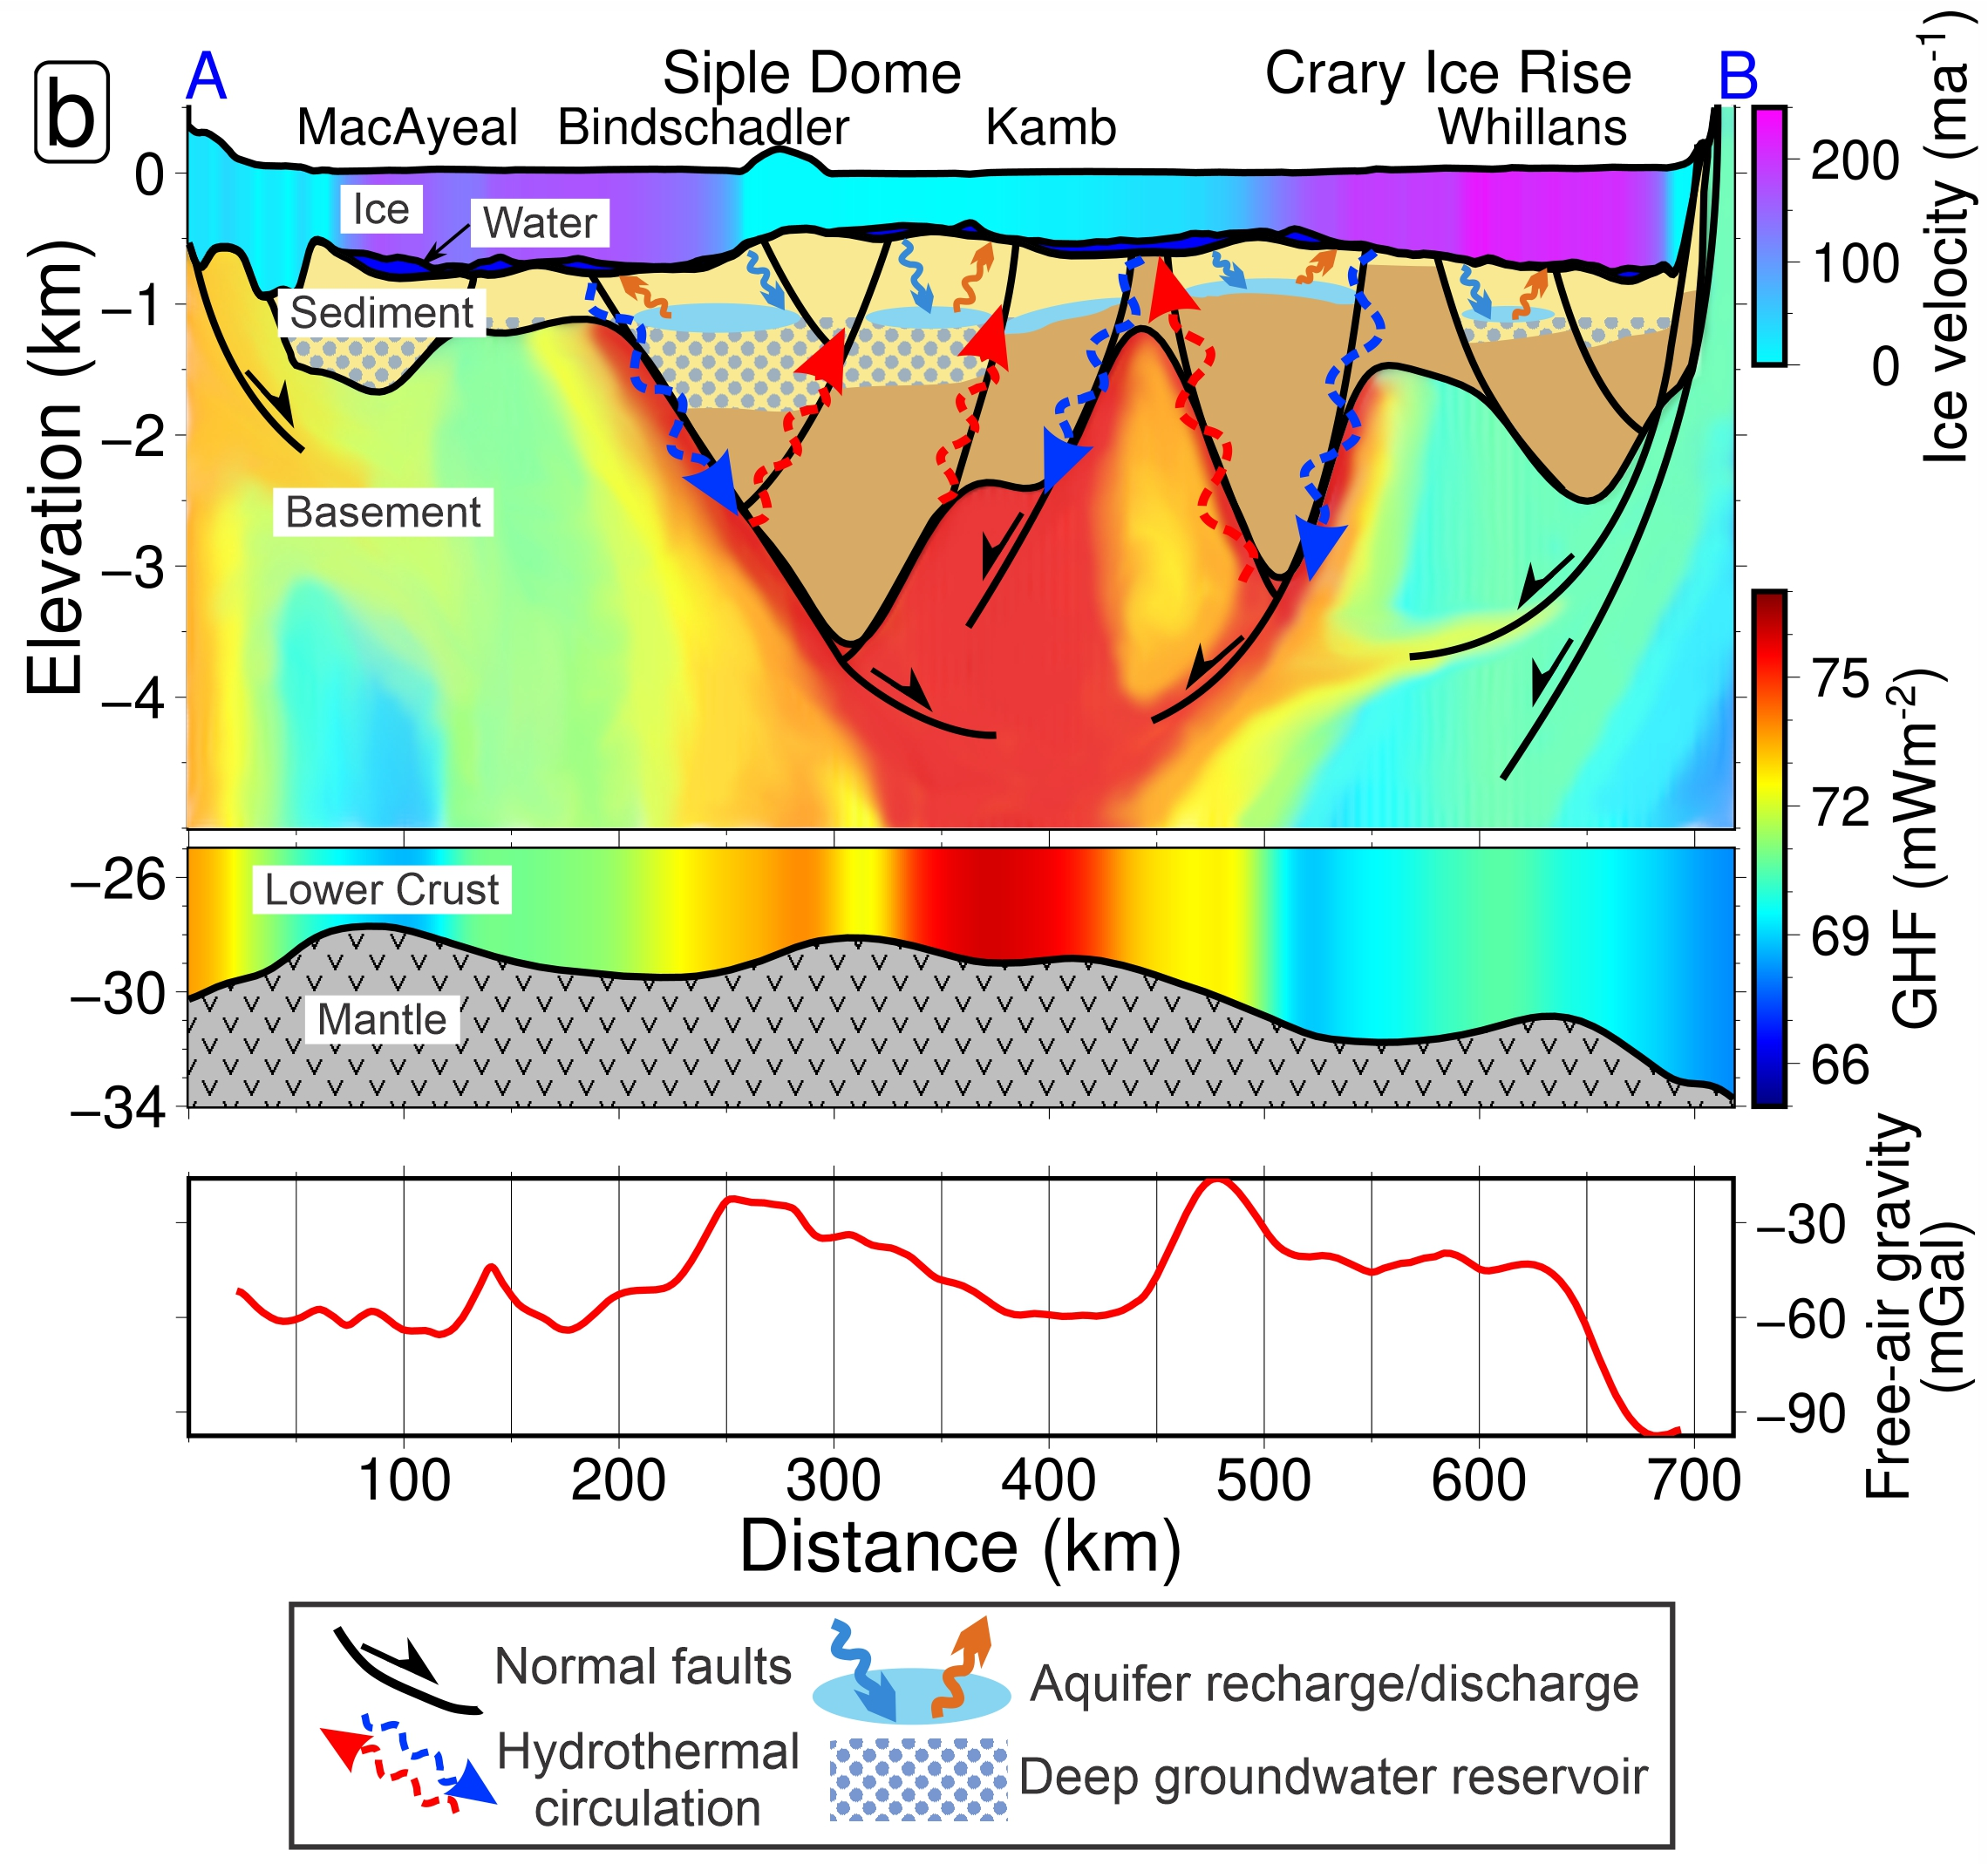
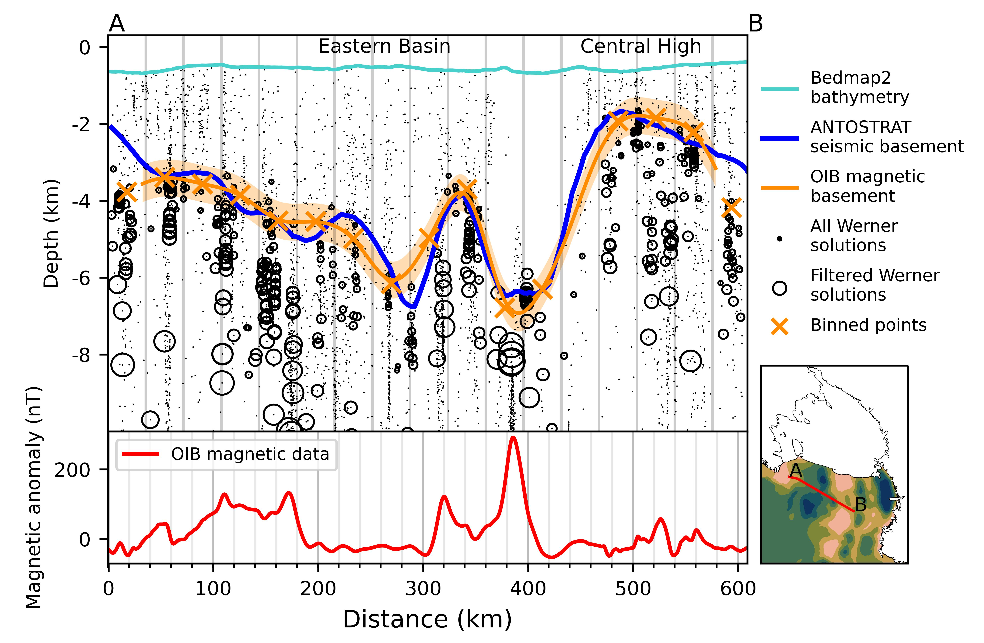
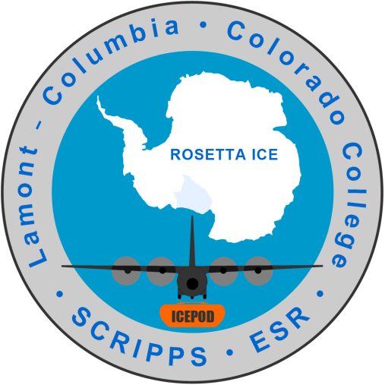





Revealing sub-ice shelf sediment basins with airborne magnetics
Matthew Tankersley^{1,2}, Christine Siddoway³, Huw Horgan¹, Fabio Caratori Tontini^{2,4}, Kirsty Tinto⁵ ¹Antarctic Research Centre, Victoria University of Wellington, NZ ²GNS Science, NZ ³Colorado College, USA ⁴University of Genova, Italy ⁵Lamont-Doherty Earth Observatory, USA
Introduction
Analysis of airborne magnetics data from the ROSETTA-Ice project reveals basement rock depths and sediment distribution beneath the Ross Ice Shelf (RIS). We use the resulting basement topography to highlight sites of possible influence upon the Antarctic Ice Sheet and to further understand the tectonic history of the region.
Methods
Use Werner deconvolution of airborne magnetic data to map the contact between magnetic rocks (basement) and non-magnetic overlying sediments.
Develop the method in Ross Sea with Operation Ice Bridge (OIB¹) aeromagnetics and ANTOSTRAT² seismic basement.
Use coincident OIB and ROSETTA-Ice³ lines to determine sub-RIS basement depths.
Merged RIS results with regional basement depths⁴
Subtract from bathymetry⁵ to get sediment thickness
Results
Continuous drape of sediment, 50-3800m thick
Fault-bound basins from West Antarctic Rift System extension
Broad basement highs, likely locations for initialization of Oligocene ice
Mid-Shelf High separates East/West Antarctic geology
East Ant. is deeper, distributed extension
West Ant. is shallower, linear, narrow, deep basins
Siple Coast basins indicate active rifting
Faults concentrate GHF / groundwater transport
Siple Coast cross-section (A-B)
Ice surface, ice base, and bathymetry from Bedmachine⁵. Basement from this study. Moho from Shen et al. 2018⁶. Ice is colored by velocity⁷. Sediment layer shows interpreted faults, offset beds, aquifers, and water transport. Lower crust, between -25km and Moho, shows GHF model⁸ . Upper crust is theoretical GHF, guided by inferred fault locations. Lower panel shows ROSETTA-Ice gravity
Ross Embayment basement elevations. Data under the RIS are from this study, while offshore data (below ~78°S) are from a regional compilation⁴, mostly ANTOSTRAT³. OIB¹ flights paths used for the tie are shown. A-B cross-section profile shown in white.
References
1. Cochran et al. 2014, DOI: 10.5067/OY7C2Y61YSYW
2. Brancolini et al. 1995, DOI: 10.1002/9781118669013
3. Tinto et al. 2019, DOI: 10.1038/s41561-019-0370-2
4. Lindeque et al. 2016, DOI: 10.1002/2016GC006401
5. Morlighem et al. 2020, DOI: 10.1038/s41561-019-0510-8
6. Shen et al. 2018, DOI: 10.1029/2017JB015346
7. Mouginot et al. 2019, DOI: 10.1029/2019GL083826
8. Burton-Johnson et al. 2020, DOI: 10.5194/tc-2020-59
View the paper
doi:10.1029/2021GL097371
Download the poster
doi:10.1029/2021GL097371
Notes:
1 min intro:
Hi everyone, I’ll be presenting a poster focused on the solid-earth – cryosphere interactions of the Ross Ice Shelf region. For the Ross Ice Shelf, this solid-earth portion is hidden by 100’s to 1000’s of meters of sedimentary deposits, seawater, and the floating ice shelf. Our research here uses airborne magnetics data to strip away those layer to discover the shape of the underlying basement rock. From this, we’ve identified large, fault bound, sedimentary basins, up to 3 km thick, which likely have a strong influence on important boundary conditions, such as geothermal heat flow and ground water transport. If you’re interested in hearing more about this, please come by my poster.
Between the sediment basins, we find large basement highs with thin sedimentary cover. Some of these were likely above sea level mountain ranges during the initial phases of Antarctic glaciation and have thus influence the .
30 sec run through:
For this research we wanted to find out the thickness of the sediments beneath the Ross Ice Shelf, and then determine the shape of the basement rock surface underneath those sediments. We were able to do this using airborne magnetics data and some seismic constraints. Our results show a series of large sedimentary basin, with over 3km of sediments, as well as broad shallow basement ridges. We believe both of these features, either in the past, or currently, influence several important boundary conditions for the ice sheet.

